Slide 1


Flexi Benefit Plan Details: FY 2011-12
Bank Accounts
Salary Structure
Tax planning
Retirement benefits
Payroll Team – FICO SAP Labs India

Slide 2
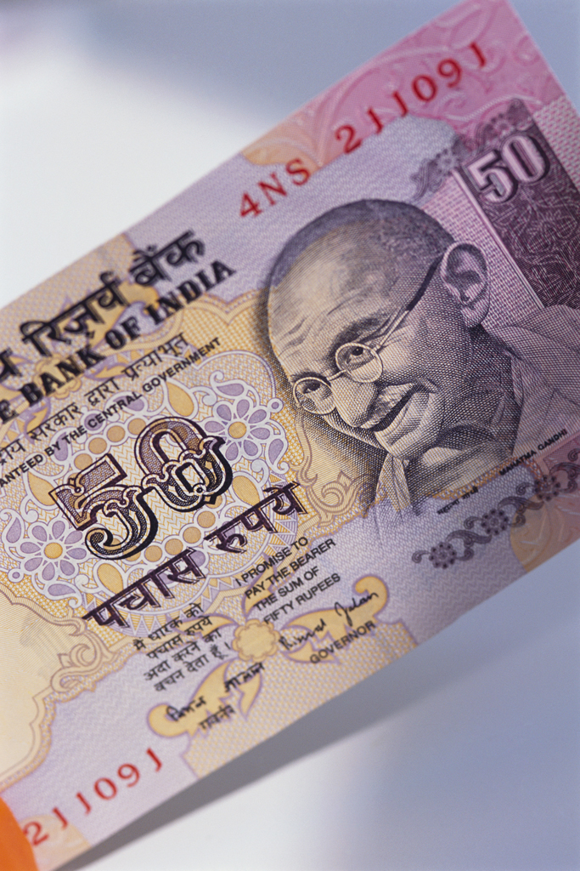
Bank Account Details
Corporate has tie up with 3 Bankers
Citi Bank
HDFC Bank
Deutsche Bank
New Account Opening
Citi Bank (Help Desk on every Wednesday)
HDFC Bank (Help Desk on every Thursday)
Deutsche Bank
Existing Account Holders
Citi Bank
HDFC Bank
Deutsche Bank
HSBC Bank

Slide 3
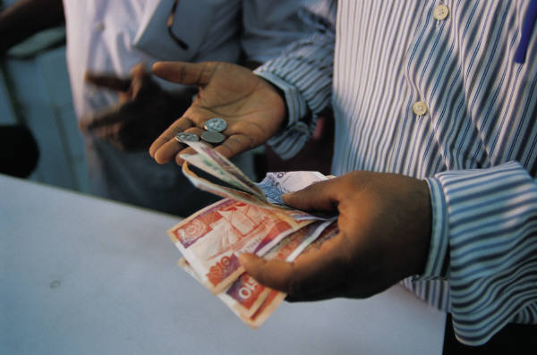
Salary Structure
This Compensation plan provides you the flexibility to structure your salary from within a given choices
It allows you to influence the design of your package in ways that suit your present and future needs
Overall the salary is defined as:
Base Salary
Basic
Flexi Compensation
Allowances
Benefits Allowance
Superannuation Allowance
Retirement Benefits
PF
Gratuity
Variable Pay
Base Salary is split into 2 major components:
Basic Salary – 35%
Flexible Compensation – 65%

Slide 4

Flexible Compensation – 65%
Flexible Compensation makes up to 65% of your Base Salary
This part comprises of the following components:
House Rent Allowance (HRA)
Medical Reimbursement
Leave Travel Reimbursement (LTR)
Children Education Allowance (CEA)
Professional Development Allowance (PDA)
Car lease allowance
Telephone Reimbursement
Transport allowance
Special Allowance
Employees can plan their salary structure based on the above listed components to suit their requirements
The limits and tax benefits for each of the above components are listed in the following slides

Slide 5

House Rent Allowance - HRA
HRA
This is one of the best tax saving options, provided the employee stays in a rented house.
The tax benefit is calculated as least of the following:
Actual HRA/Rent paid
40% of Basic Salary
Rent minus 10% of Basic Salary
Recommended is to always keep this allowance at 40% of basic salary
This will allow you to take the maximum benefit possible under HRA
Note: Please note that the employees who are staying at Delhi can keep their HRA maximum up to 50% of their Basic.

Slide 6

Medical Reimbursement
Medical Reimbursement
Medical Reimbursement will be paid to the maximum of 15000.00 INR per annum.
The amount is paid against submission of original bills and Tax benefit is provided only to the extent of submitted original bills, incurred in the financial year.
Bills can be for any medicines purchased, doctors fee, medical checkup, for you and your dependents.
No hospitalization expenses are allowed under this category.
For Spectacle bills, Power card or Doctor Prescription is required
Un-claimed medical reimbursement amount will be paid to employee as a Taxable Allowance in March every year

Slide 7

Leave Travel Reimbursement
LTA
Leave Travel Reimbursement will be paid to the maximum of 60,000 INR per annum
Tax benefit will be given for 2 journeys in the block of 4 years, as per the Income Tax rules (the present block is Jan 2010-Dec 2013)
One journey is considered as one round trip, anywhere in India, starting from the place of your work
Original Tickets have to be submitted to claim the tax benefit
The amount is paid against submission of original bills and Tax benefit is provided only to the extent of submitted original bills, incurred in the financial year.
Un-claimed leave travel reimbursement amount will be paid to employee as a Taxable Allowance in March every year

Slide 8

Professional Development Allowance - PDA
PDA
Professional Development Allowance can be utilized for the following:
To pay course fees for any further studies
To buy books or CD’s
To take up any memberships or certification courses
All the above should be in line with your nature of Job and should be approved by your respective Manager
The amount will be paid directly to the vendor or to the institution
This amount is not shown in the employees income statement
Any employee opted for PDA and not able to utilize the same, such amount will be paid back to the employee in March salary and fully taxed

Slide 9

Car lease Allowance
Car lease Allowance
This component is applicable for employees who have availed a car under company car lease scheme (Existing Car Lease Policy and New Racer Policy)
Employee portion of EMI amount will be parked under this component. Employee should not input any amount here since payroll will fill this in
Employee will get a tax benefit for the amount mentioned under car lease allowance
Employee will get petrol allowance based on their eligibility (this allowance will not be paid for those who have availed a car under racer policy)
Perquisite on car is taxable

Slide 10
Telephone Reimbursement
Telephone Expense Reimbursement
An amount of Rs.24,000/- per annum will be reimbursed
When opted for this component, the amount is paid against submission of bills
Employee can claim this reimbursement for one Landline and one Mobile phone
Employees have to submit original bills along with proof of payment
Un-utilized amount will be paid back to the employee as “Taxable balance payment” at the end of the financial year
In case of separation, un-utilized telephone reimbursement amount will be paid to you in your last month payroll
This reimbursement facility (landline and mobile) is not available for those who have a Company provided Landline or Company Provided Mobile phone (including black berry)
Mobile phone should be in the name of employee only
Landline should be located in the city where the employee resides (basically where SAP offices are located)
Employee has to give a declaration stating that the phone has been used for official purposes also

Slide 11
Transport Allowance
Transport Allowance
Eligible for those who commute on their own transport.
Employees who use company shuttle services are not eligible.
Employees who have availed the car under car lease scheme including racer policy are not eligible to claim this benefit
Maximum eligibility and deduction is Rs 9600/- per annum for those who are eligible

Slide 12
Children Education Allowance
CEA
Rs.100/- per child per month to a max of 2 children will be paid as Children Education Allowance
Copies of the Fee receipts have to be submitted for claiming the tax benefit

Slide 13

Special Allowance
Special Allowance
This is the balance amount out of your Flexible Compensation after allocating for other component
This allowance is fully taxable

Slide 14
Retirement benefits
Provident Fund
Regional Provident Fund Commissioner, Bangalore ( RPFC, Bangalore )
Transfer process
RPFC to RPFC Yes
Trust to RPFC Yes
Superannuation allowance
Employee has an option to select this allowance as part of their monthly salary or retirement benefit
Part of monthly salary payouts does not have any additional tax benefit
For retirement benefit there is a maximum cap Rs 1 Lac per annum
Employees who opt for retirement benefit, will get additional tax benefit up to Rs 1 Lac per annum.
Gratuity benefit
Employee who completes 2 years service with SAP Labs are eligible for this benefit
Employee will get ½ month basic salary for every completed year of service
Settlement amount up to Rs 10 Lakhs not taxable

Slide 15

Thank You!
E-mail – LabsIndia.payroll@sap.com
Phone – Bangalore: 7300
Gurgaon :7724

